Slide 1
EMOTION DETECTION IN SPEECH
-A Comparative Study of State-of-the-Art Approaches

Slide 2
Intro
Classify spoken audio into predefined emotional categories
Happy
Sad
Angry
Calm
Surprised, etc.

Slide 3
Real-World Importance
Virtual Assistants
Healthcare
Customer Service
Security & Surveillance
Enhances user experience
Emotional well-being monitoring
Customer sentiment detection
Identifies stress or aggression

Slide 4
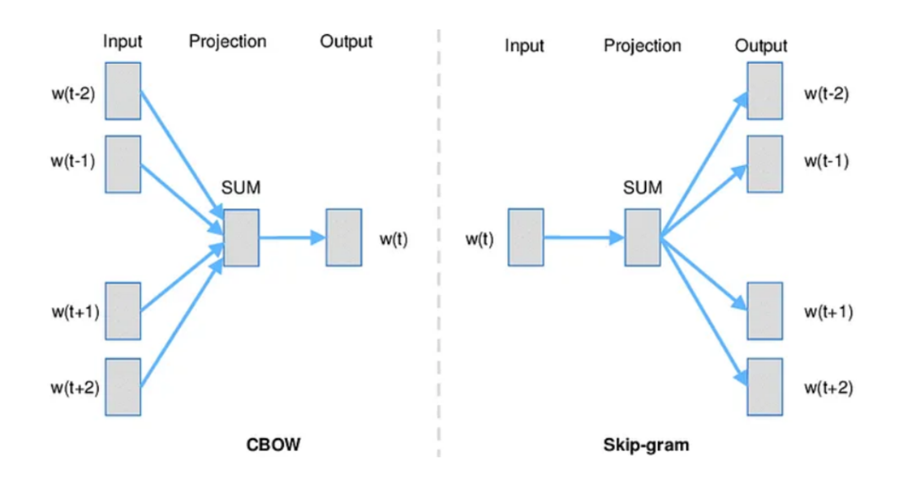
Learning Approaches
Traditional Machine Learning Approaches
Support Vector Machines (SVM)
Random Forest
k-NN models
Deep Learning-Based Approaches
CNN-Based Models
Recurrent Neural Networks (RNNs) & Transformers
Self-Supervised Learning (SSL) Approaches

Slide 5
30%
Deep learning models improve accuracy by ~10-30% compared to traditional methods.

Slide 6
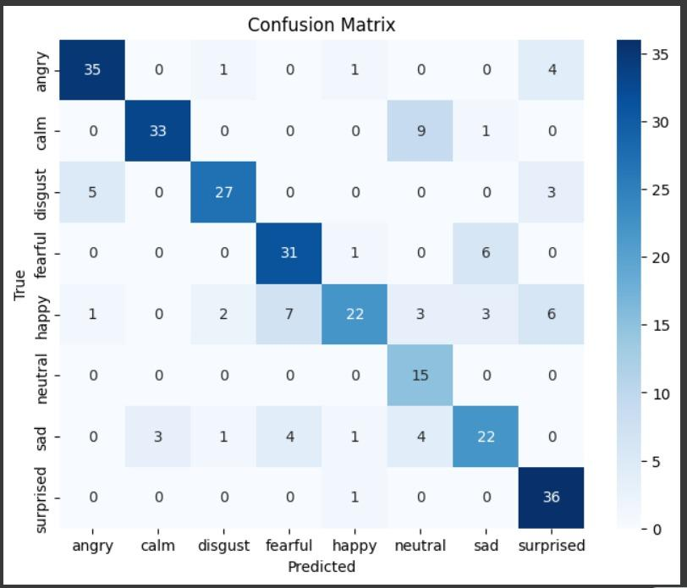
Evaluation Metrics
Accuracy
Precision
Recall
F1-score
Confusion Matrix

Slide 7

Results
Overall Accuracy: 76.7%
Angry (85% Precision, 85% Recall)
Surprised (73% Precision, 97% Recall).
Neutral (48% Precision, 100% Recall)
Happy (85% Precision, 50% Recall)

Slide 8
Wav2Vec2.0 or HuBERT-based models are preferred due to their robustness, while SVM remains a lightweight alternative for low-resource scenarios

Slide 9
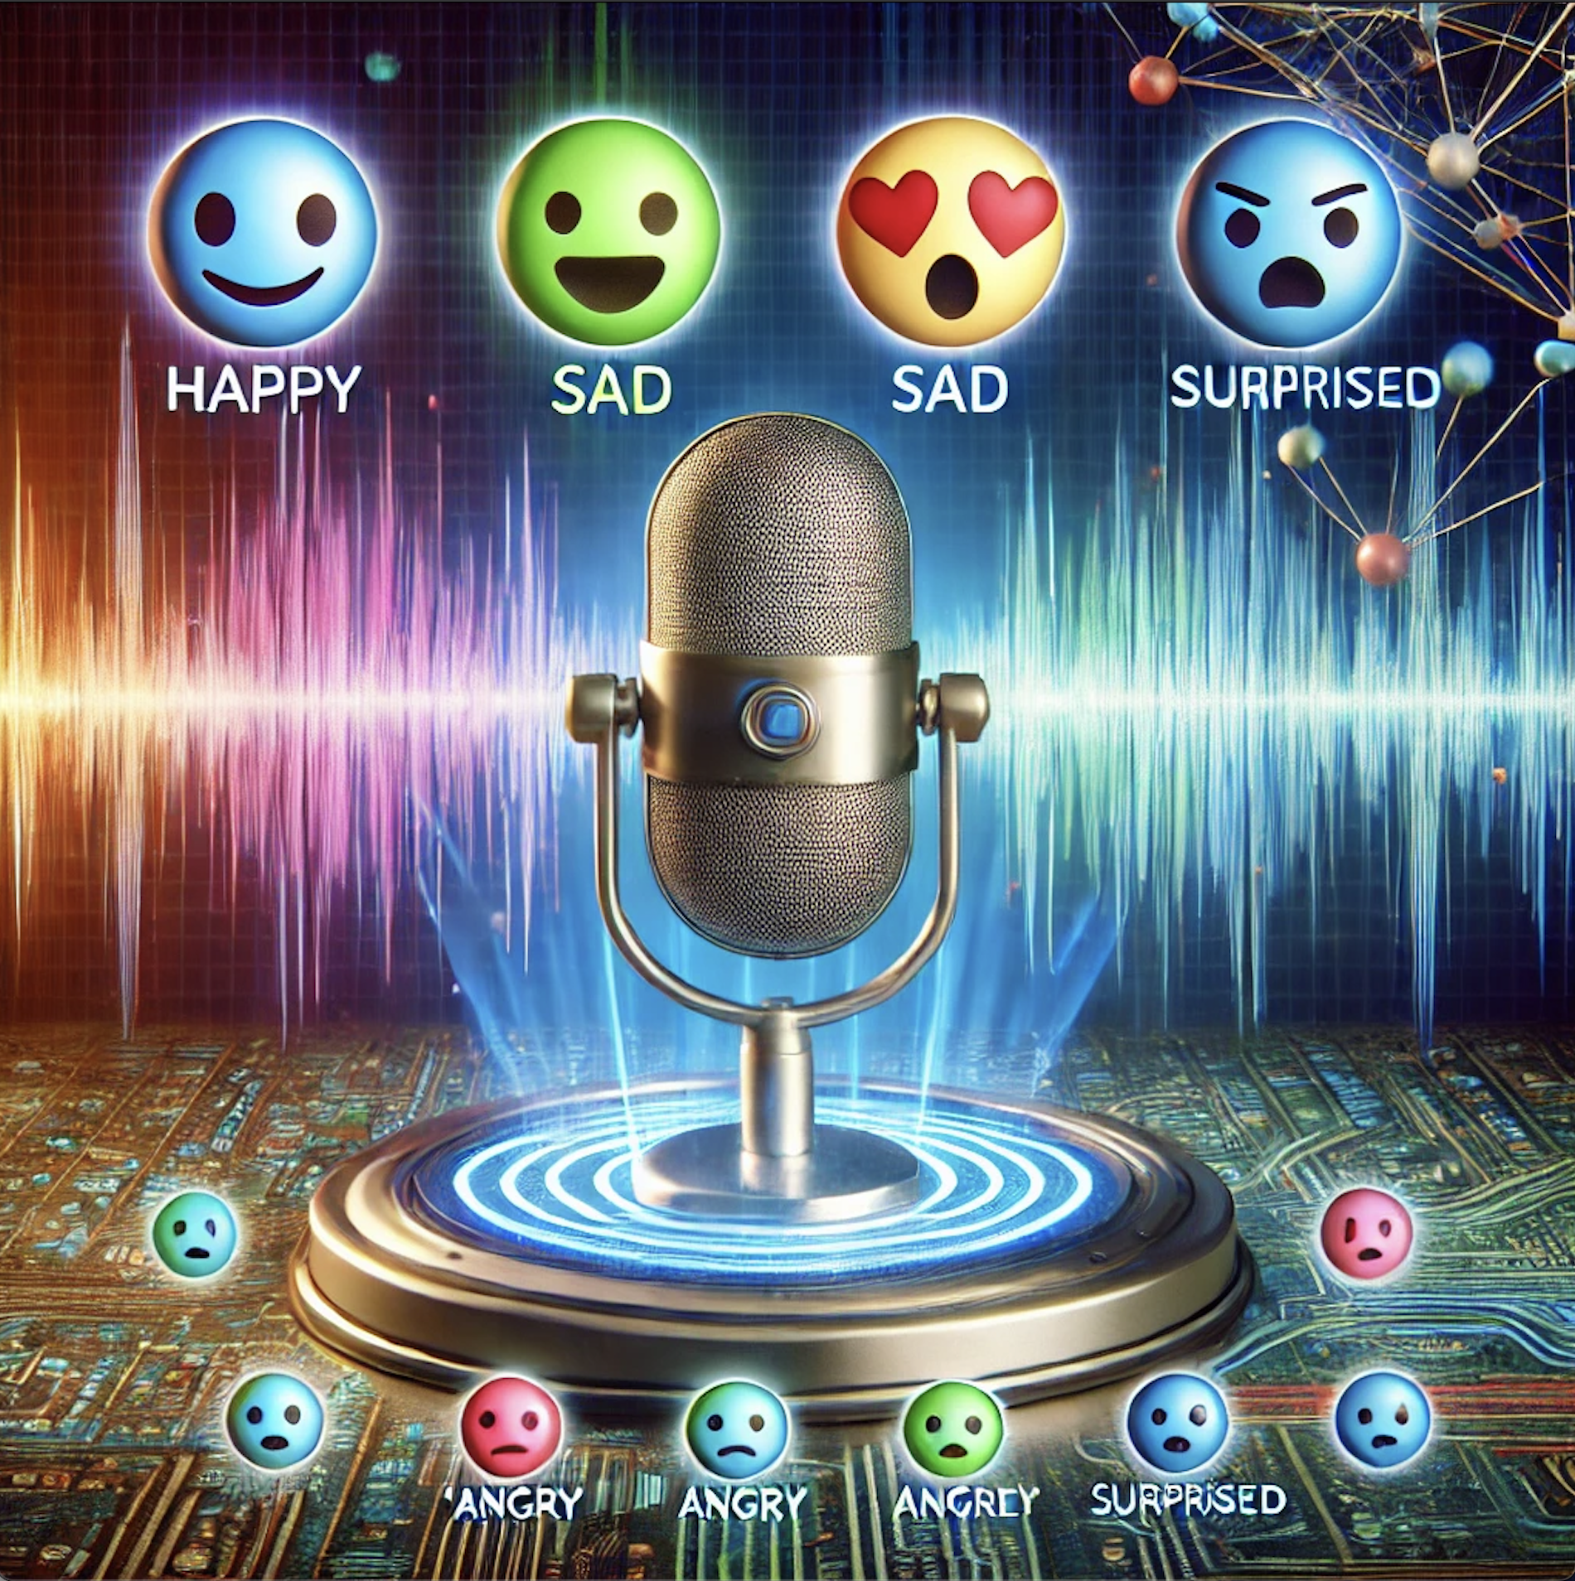
Thanks!
Pranjal Malik (M24CSA021)
Jyotishman Das (M24CSA013)

